Slide 1
Building your Shopping Annuity®!
Notes:
It’s no longer a concept, it’s a reality.

Slide 2
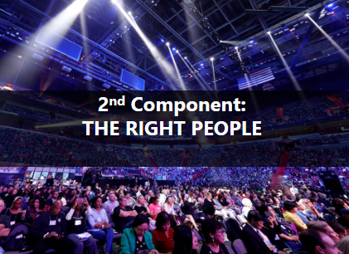
What does the Shopping Annuity consist of？

Slide 3
4
Change Your Shopping Habit
STEPS To BUILD A
SHOPPING ANNUITY®
1
Use your own Exclusive Brands
- BV
2
Buy other brands and product with Partnerstores on your SG.SHOP.COM
- IBV
3
Teach, guide and show your business
partners to do the same
- Duplication
4
Teach , guide and show your customers to do step 1 and 2
- Duplication
Notes:
TRAINERS NOTES:
Transitional slide.
The big point to make here is that there is proven system and tools to support the actions required to be successful. You don’t have to ambiguously go about funding your shopping annuity. You can make calculated decisions and duplicate that process with your team to create a shopping annuity for yourself.

Slide 4
marketsingapore®
A product brokerage company.
We looks for products in billon dollar industries!
Best
Products
Best
Suppliers
Quick to
Market
Huge Market Opportunity

Slide 6
Heart Health™ Advanced LipiTrim™

Slide 7
We are delivering!
Notes:
Trial Size product

Slide 8
ISOTONIX
ESSENTIALS™
TURN UP
TURN DOWN
ENERGY • ALERTNESS • BRAIN HEALTH
CALMNESS • RELAXATION • SLEEP
COMPLEXION • BALANCE
• VITALITY

Slide 10
Coffee or Tea?

Slide 11
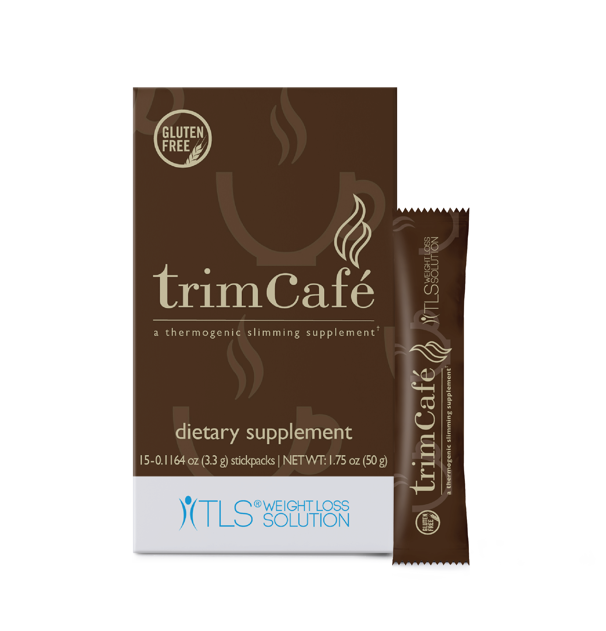
INTRODUCING
THE REVOLUTIONARY NEW COFFEE PRODUCT!
Notes:
Reference trim café booth

Slide 12
DISCLAIMER
Products mentioned are not intended to diagnose, treat, cure, or prevent any disease.

Slide 13
Heart Health™ Advanced LipiTrim™
Code:SG13848
Pricing: UC: S$52.25 SR:S$73.25 BV: 27

Slide 14
Heart Health™ Advanced LipiTrim™
Promotes healthy cholesterol production
Helps support healthy levels of total cholesterol, LDL cholesterol and triglyceride levels
Helps support healthy cardiovascular function
Supports healthy blood vessels
Provides antioxidant support for the heart

Slide 15
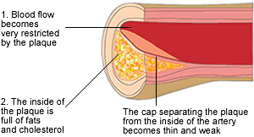
What Happens When LDL(Bad Cholesterol) Is High?
Too much of LDL increases the risk that cholesterol will slowly build up in the inner walls of the arteries.
Cholesterol can join with other substances to form a thick, hard deposit on the inside of the arteries.
This can narrow the arteries and make them less flexible – a condition known as atherosclerosis.
If a blood clot forms and blocks one of these narrowed arteries, a heart attack or stroke can result.
American Heart Association

Slide 16
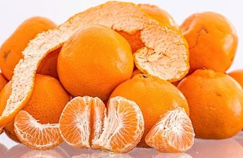
How Does Heart Health™ LipiTrim™ Ingredient Works?
LipiTrim supports healthy LDL levels
Capros® Indian gooseberry fruit supports healthy cholesterol levels by reducing an important enzyme for cholesterol synthesis in the liver
LipiTrim may increase HDL level
Capros® Indian gooseberry fruit appears to increase HDL. HDL transports excess cholesterol from the heart and back to the liver for elimination and it also prevents the oxidation of LDL.
Capros® is a registered trademark of Natreon, Inc. and is protected under U.S. Patent No. 6,124,268

Slide 17
Who should take Lipitrim™
People with family history of:
- Cardiovascular disease
- High cholesterol
- High triglycerides
- High LDL (Bad Cholesterol)
- Low HDL (Good Cholesterol)
1 capsule in the morning 1 capsule in the evening for total 2 capsules daily
Recommended dietary supplements to take in conjunction with Lipitrim for maximum results;
Heart Health™ Essential Omega III Fish Oil with vitamin E
Isotonix® Coenzyme Q10
Ministry Of Health

Slide 18
ISOTONIX
ESSENTIALS™
LIFESTYLE
Isotonix® products are scientifically formulated to ensure an isotonic state the moment they enter your body.
When properly mixed with water and taken on an empty stomach, the isotonic solution flows into your small intestine almost immediately.

Slide 19
TURN UP
ENERGY • ALERTNESS • BRAIN HEALTH
Isotonix Essentials™ Turn Up is a custom blend of vitamins, amino acids and minerals designed for anyone who needs a daily boost.
Code: SG6703
Pricing: UC: S$78.50 SR: S$110.00 BV: 40

Slide 20
TURN UP
Helps support energy
Provides antioxidant support
Helps maintain alertness
Supports brain health
Ideal for those looking to increase energy and support cognitive health
take once daily on empty stomach for maximum absorption

Slide 21
TURN DOWN
CALMNESS • RELAXATION• SLEEP
Designed for relaxation, Isotonix Essentials™ Turn Down features a custom blend of vitamins, amino acids and minerals
Code: SG6702
Pricing: UC: S$69.75 SR: S$97.75 BV: 35

Slide 22
TURN DOWN
May promote calmness and relaxation
Supports sleep quality
Supports enzyme and hormone production
Supports brain health
Ideal for those want to enhance and stabilise mood, promote mental clarity and support a healthy sleep quality.
take once daily on empty stomach for maximum absorption

Slide 23
Coming Soon
WOMEN’S HEALTH
COMPLEXION • BALANCE • VITALITY
More than a multivitamin, Isotonix Women’s Health benefits women by providing a foundation of nutrients that deliver vibrancy.
Code: SG6701
Pricing: UC: S$78.50 SR: S$110.00 BV: 40

Slide 24
Women’s Health
Supports a healthy complexion Helps support healthy bones, teeth and joints
Supports healthy muscle and nerve function
Supports cardiovascular health
Females 18 years of age and older who want to support healthy skin and body, specific to women’s needs
take once daily on empty stomach for maximum absorption

Slide 25
WOMEN’S
HEALTH
Supports a healthy complexion Helps support healthy bones, teeth and joints
Supports healthy muscle and nerve function
Supports cardiovascular health
Females 18 years of age and older who want to support healthy skin and body, specific to women’s needs
take once daily on empty stomach for maximum absorption

Slide 26
What are customers looking for?
Clean Ingredients
No GMO Detected
Gluten Free
Options
Clear Instructions
Results
SUCCESS

Slide 27
Two Major Ingredients
Ingredient 1:
Colombian Arabica Coffee Powder
Ingredient 2:
WellTrim® iG

Slide 28
Two Ingredients- Simple In Its Perfection
3 grams of Colombian Arabica Coffee Powder
This is a finely ground coffee powder
Contains the same amount of caffeine as a standard cup of black coffee
Notes:
this is about 25-30 mg less than an 8 ounce cup of coffee

Slide 29
Two Ingredients- Simple In Its Perfection
300 mg of the trademarked ingredient WellTrim® iG
Same amount of the WellTrim® iG ingredient used in clinical trial
WellTrim® iG is a plant derived ingredient that has been clinically tested for healthy weight management and fat-burning
WellTrim® iG is a trademark of Icon Group, LLC

Slide 30
TLS™ trim café is a gluten-free, slimming supplement that
May help to curb appetite
May promote a feeling of fullness
Supports healthy weight management
Promotes fat burning
Notes:
I will point out how this is different than CORE. That they can be taken together

Slide 31
Leptin Sensitivity
WellTrim® iG /Irvingia gabonensis appears to naturally support leptin’s ability to enter the brain and signal the stomach that it is full.
Supports Adiponectin Levels
WellTrim® iG /Irvingia gabonensis supports the hormone adiponectin which has been associated with fat burning.

Slide 32
COFFEE
$30 Billion Industry
1.4 billion cups of coffee served globally everyday
83% of Adults Drink Coffee
Today, we are changing the coffee industry!
Notes:
1.4 billions cups of coffee served globally everyday

Slide 33
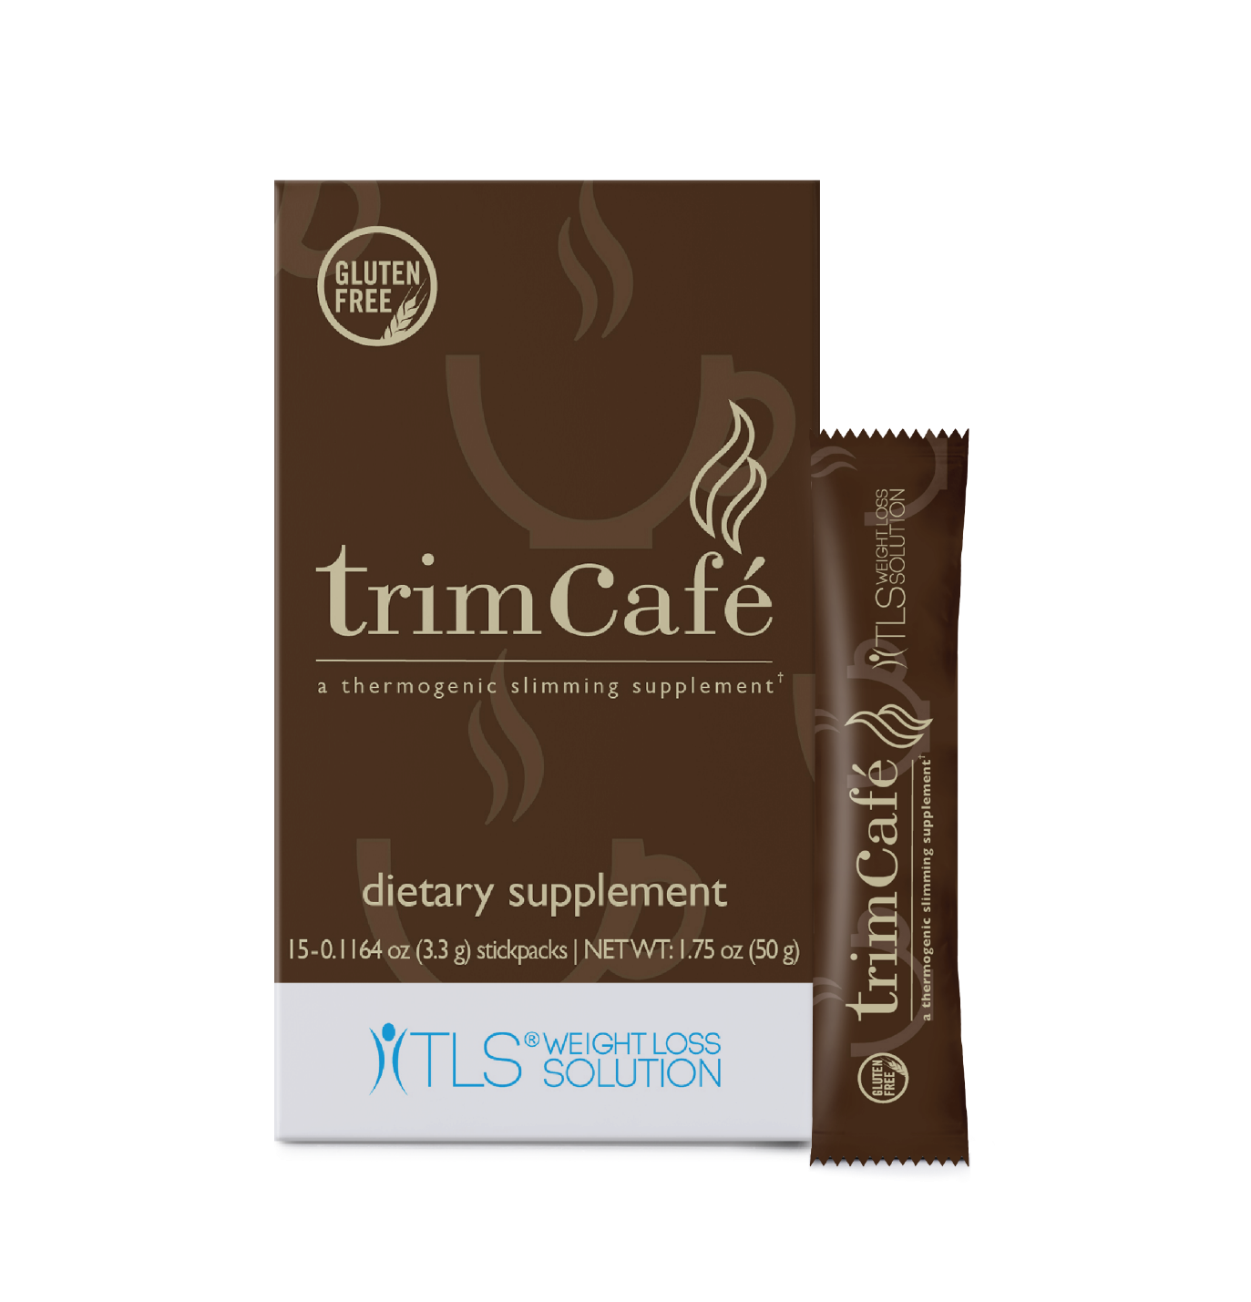
The average price per cup of Coffee
TLS™ trim café (15 servings) SKU： SG6612
UC: S$78.50
SR: S$46.25 BV:22
S$4.90
Per cup!
S$4.30
Per cup!
And you lose weight!

Slide 34
We are just getting started!
BV
OUR NEXT MISSION:
BV
BV
Provide Every Day Consumable Products
Notes:
Pop out BV

Slide 35
Shopping Annuity® Premium Natural Whitening Toothpaste
Supported by bromelain and papain.
Contains:
2 enzymes that whiten teeth
Calcium carbonate polishing agent
No artificial colours, flavours or sweeteners
LAUNCHED
Best In Class!
50%
BV
SG13703

Slide 36
Want a sneak peek at what’s coming soon?

Slide 37
INTRODUCING
Notes:
Introducing… then bring in the handsoap
All countries

Slide 38
Organic Hand Soap
Cleanses & Moisturises all skin types
Free of
Detergents
Sulfates
Fragrances & alcohol
Artificial colours
GMOs
Certified USDA Organic
Coming Soon
SG1401
Notes:
Introducing… then bring in the handsoap
All countries

Slide 39
Deodorant
Free of aluminum, parabens & silicones
Safe for all skin types
Cruelty Free
Fresh Clean Scent
For both Men & Women!
BV
Coming Soon
SG22072
Notes:
All countries

Slide 40
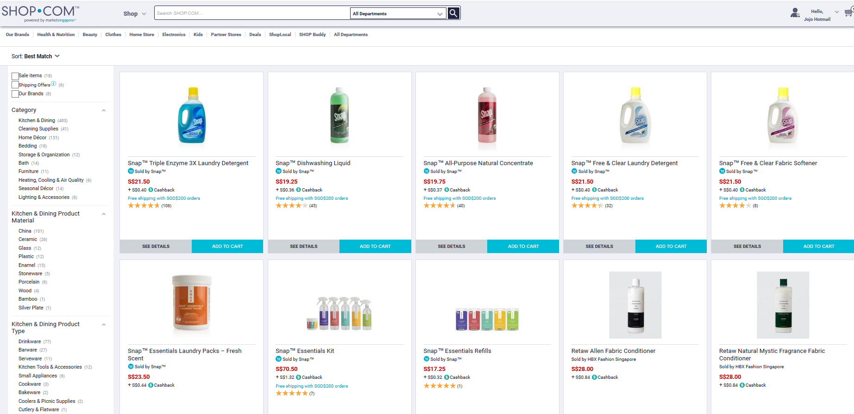
Your SHOP.COM Stores

Slide 41
17 years ago, we introduced IBV.

Slide 42
IBV COMPENSATION PLAN
To give you a new stream of income via partnerstore purchases.
By going back to basics, we are going to reward you with more IBV than ever before!
Notes:
Merge with previous

Slide 43
Increase existing IBV for ufos
Was
2% IBV
Was
2% IBV
Was
2% IBV
Was
2% IBV
Was
3% IBV
UFOs Earn Up to:
5% IBV
NOW
UFOs Earn Up to:
6% IBV
NOW
UFOs Earn Up to:
6% IBV
NOW
UFOs Earn Up to:
6% IBV
NOW
UFOs Earn Up to:
6% IBV
NOW
Notes:
Check brand if available in sg, if yes we can keep. Add more local brand which has adjust of cb and ibv increase for the pass 6 months
VC BREAK INTO 2 SLIDES – NO CLICK

Slide 44
Increase existing IBV for ufos
Was
4% IBV
Was
4% IBV
Was
2% IBV
Was 4% IBV
Was
3% IBV
UFOs Earn Up to:
8.8% IBV
NOW
UFOs Earn Up to :
8.8% IBV
NOW
UFOs Earn Up to :
8.8% IBV
NOW
UFOs Earn Up to:
11% IBV
NOW
UFOs Earn Up to:
11% IBV
NOW
Notes:
Check brand if available in sg, if yes we can keep. Add more local brand which has adjust of cb and ibv increase for the pass 6 months
VC BREAK INTO 2 SLIDES – NO CLICK

Slide 45
Increase existing IBV for ufos
Was
3% IBV
Was
2% IBV
Was 6% IBV
Was
11% IBV
Was 8% IBV
UFOs Earn Up to:
11% IBV
NOW
UFOs Earn Up to:
11% IBV
NOW
UFOs Earn Up to:
16.5% IBV
NOW
UFOs Earn Up to:
22% IBV
NOW
UFOs Earn Up to:
22% IBV
NOW
Notes:
Check brand if available in sg, if yes we can keep. Add more local brand which has adjust of cb and ibv increase for the pass 6 months
VC BREAK INTO 2 SLIDES – NO CLICK

Slide 46
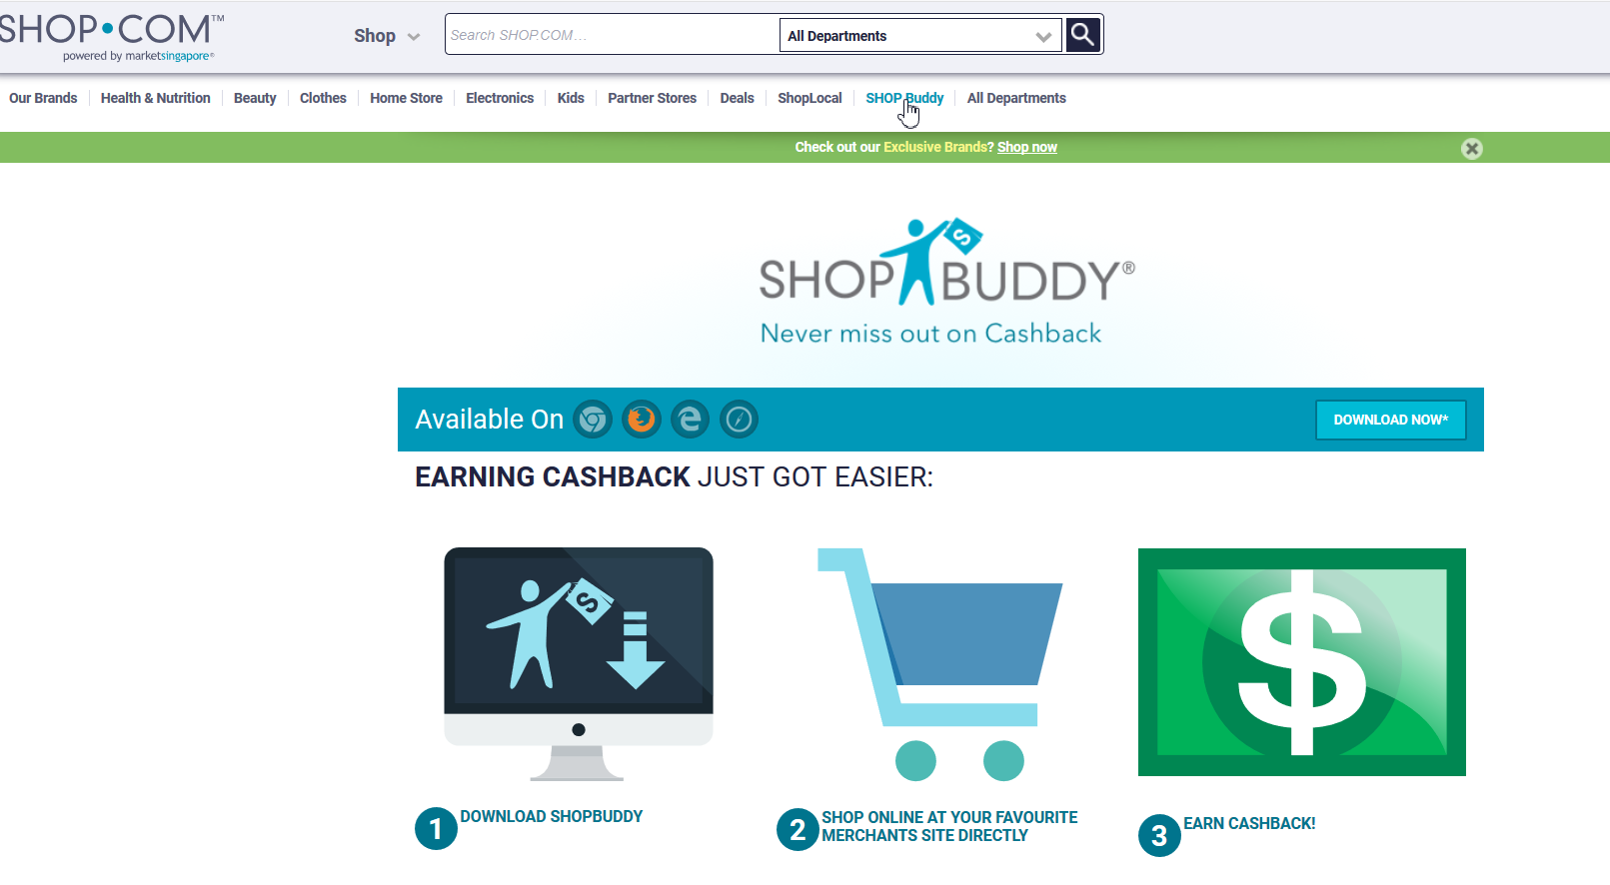
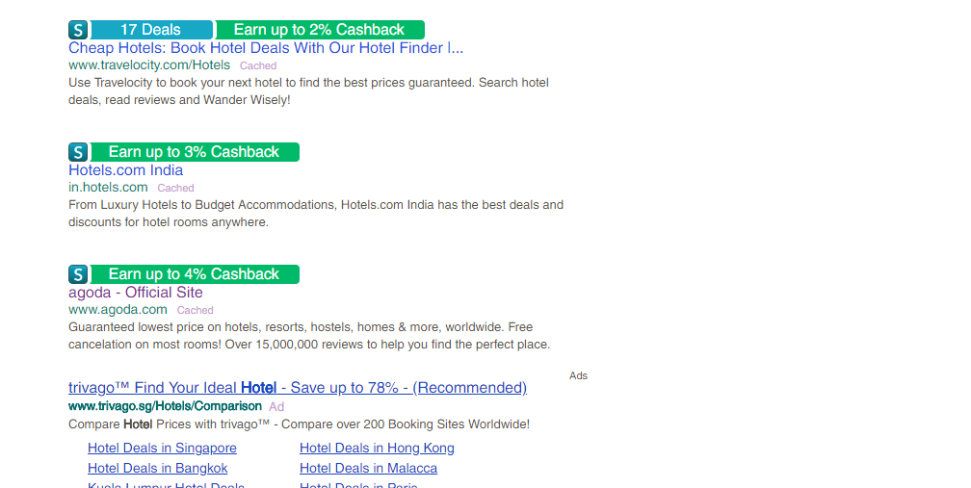
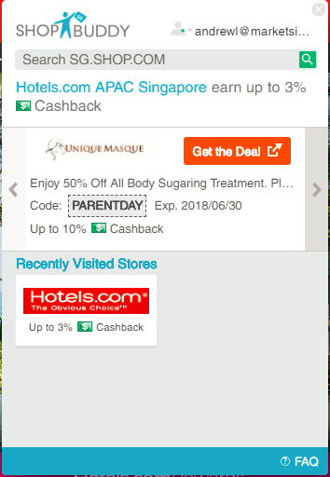

Slide 47
PARTNERSTORES PROGRAM
Over 450+ Top E-Retailers and over 350+ SHOPLocal Stores to earn IBV Commissions!
Notes:
You want more?

Slide 48
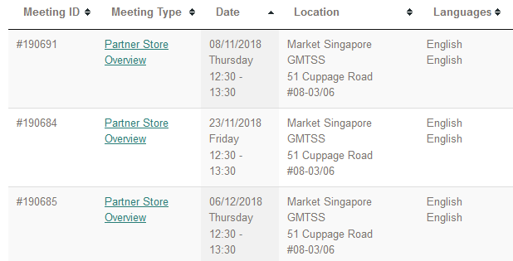
Webinar
MASG
PartnerStore Overview

Slide 49
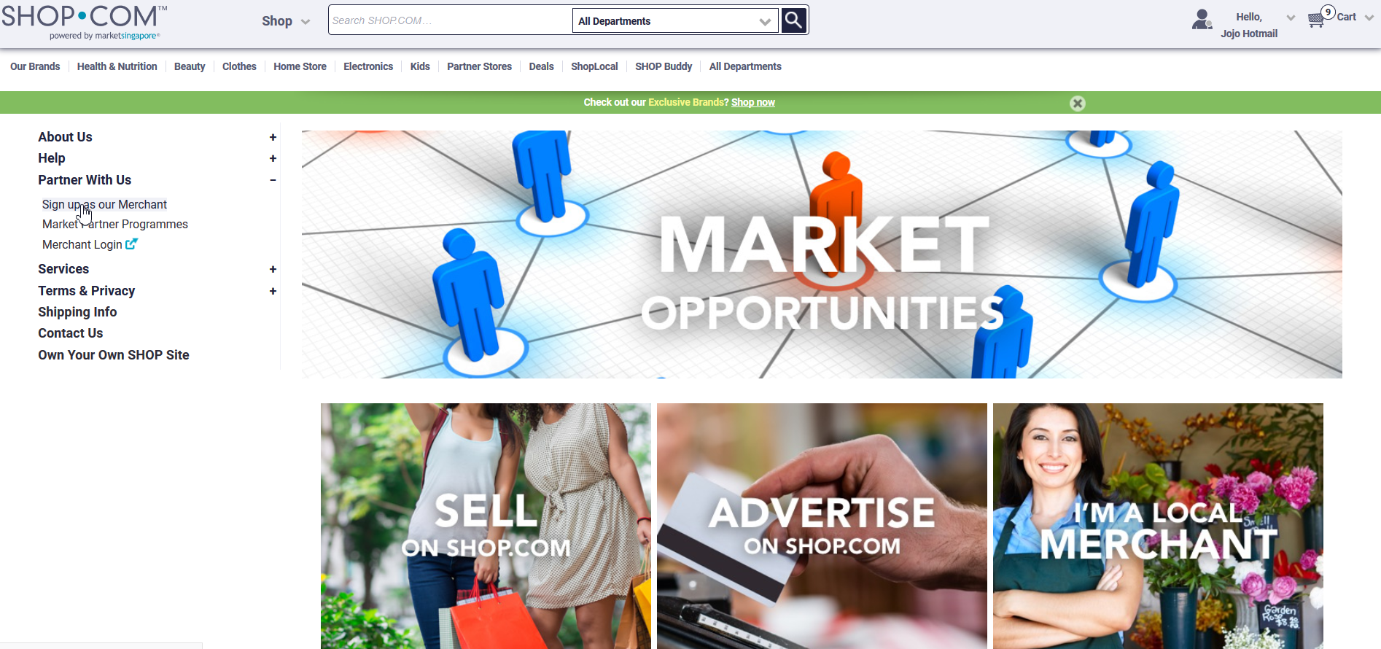
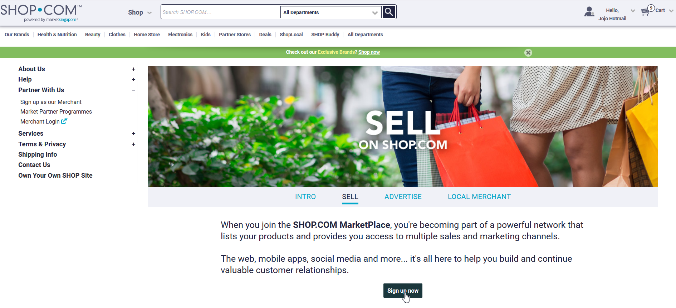

Slide 50
WE CONTINUE TO ADD
New Stores
Since SEA Convention
Notes:
New store since last event

Slide 51
WE CONTINUE TO ADD
New Stores
Since SEA Convention
Notes:
Localized to some new online PS stores (May-Sep)

Slide 52
WE CONTINUE TO ADD
New Stores
Since SEA Convention
Notes:
New store since last event

Slide 53
WE CONTINUE TO ADD
New Stores
Since SEA Convention
Notes:
Localized to some new online PS stores (May-Sep)

Slide 54
WE CONTINUE TO ADD
New Stores
Since SEA Convention
Notes:
New store since last event

Slide 57
Lucky Dip
onsite
Buy your Shop.com Prepaid Mastercard @ #MASGLS2018

Slide 58
We will continues to Grow !

Slide 59
FarEastFlora.com
One of the largest flower retailer that offer birthday flowers, a hamper to welcome a new-born baby with or customised wedding flowers and you name it.
Singtel
To all music lovers, you now can earn IBV through enjoying stream and download your favourite songs via your favourite music apps.
2% CB
6% IBV
4% IBV
Notes:
Singtel :4% IBV, Fareast Flora _ 2CB and 6IBV

Slide 60
Guavapass
is the largest community of fitness studios and healthy-living experts in your city. Get access to a wide range of studio classes and our very own GuavaPerks. They hand select the best studios across all fitness verticals including yoga, cross functional training, pilates, crossfit, dance, muay thai and many more in the city.
At EAMART
it is the best way for people anywhere in the world to shop for groceries. Join millions of shoppers worldwide, let your fingers do the shopping and let us do the heavy lifting!
2% CB
6% IBV
2% CB
5% IBV
Notes:
Guava – 2%CB 6% IBV EAmart 2%CB and 5% IBV

Slide 61
Are you with US?

